Slide 1


NEXTHIKE IT SOLUTIONS
Data Acquisition and Data Wrangling
Mr. Aniket G. Tayade.

Slide 2



Understanding Dataset 1
DATASET STRUCTURE
ISSUES FOUND
FINDINGS
Key Columns:
instant, dteday, season, yr, mnth, hr, holiday, weekday, weathersit, temp
Data types: int64, object, float64,bool.
Incorrect types
Convert ‘dteday’ column to Date Time Format.
Dataset Shape is (610, 10)
No Missing Values
After Conversion No Incorrect Datatypes

Slide 3

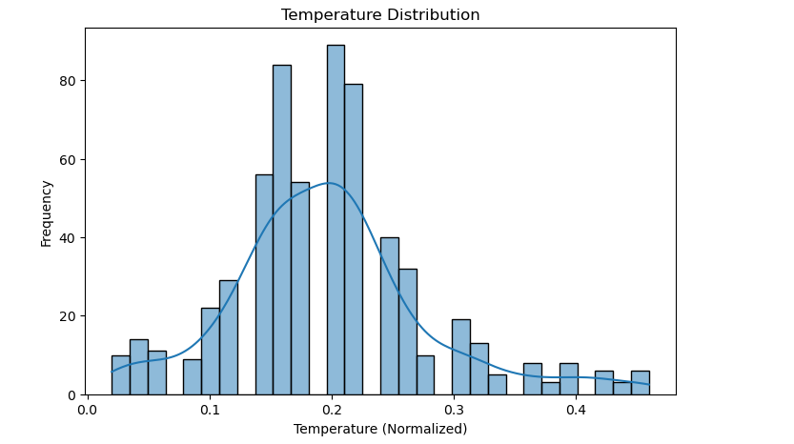

Exploring Dataset 1
PLOTS
• Histogram of temperature
INSIGHTS
• Temperature follows a normal distribution.
• Summer (season 2) weather conditions affect rental counts significantly.

Slide 4

Understanding Dataset 2
ISSUES FOUND
SOLUTIONS
DATASET STRUCTURE
Dataset Shape is (610, 8)
Key Columns:
Unnamed: 0, instant, atemp, hum, windspeed, casual, registered, cnt.
Data types: int64, float64.
Unnecessary column ‘Unnamed: 0’.
Missing values are found in ‘atemp’ columns.
Dropped the column ‘Unnamed: 0’.
Use ‘mean()’ to handle missing values.

Slide 5
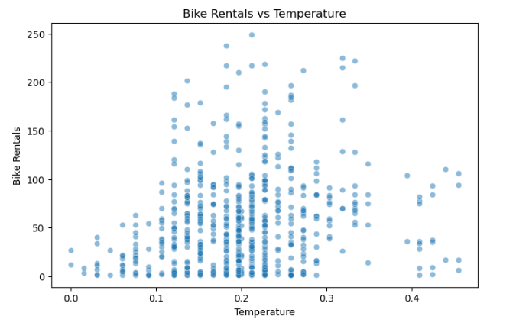
Exploring Dataset 2
PLOTS
• Scatter Plot of temperature and Bike Rental
INSIGHTS
A positive trend might indicate that warmer temperatures lead to more bike rentals.
This plot helps analyze how temperature impacts bike rental demand.

Slide 6
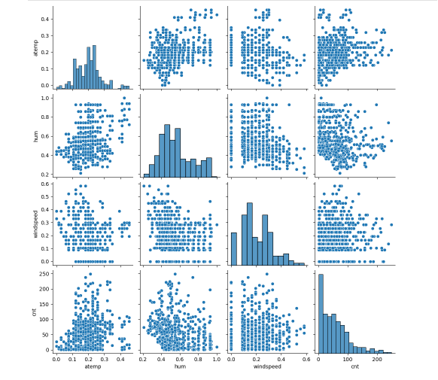
PLOTS
• Pair plot visualizes relationships between temperature , humidity, wind speed, and bike rentals
INSIGHTS
atemp vs. cnt - If there’s an upward trend, warmer temperatures lead to more bike rentals.
hum vs. cnt - A downward trend may indicate high humidity reduces bike rentals.
windspeed vs. cnt - If points are scattered, wind speed may have little impact on rentals.

Slide 7
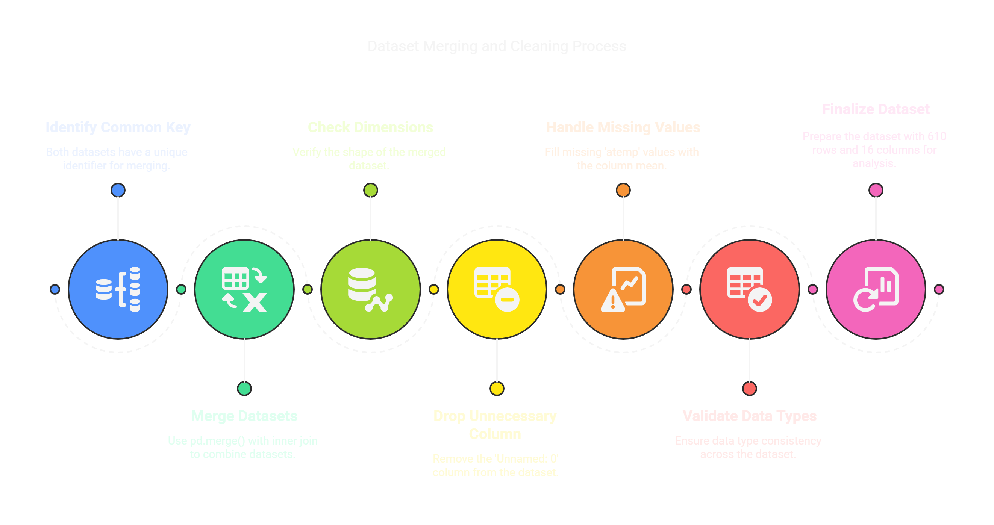
Merging Dataset 1 and Dataset 2

Slide 8
Understanding Dataset 3
DATASET STRUCTURE
ISSUES FOUND
FINDINGS
Key Columns: instant, dteday, season, yr, mnth, hr, holiday, weekday, weathersit, temp, atemp, hum, windspeed, casual, registered, cnt
Data types: int64, object, float64,bool.
‘dteday’ was initially an object → Converted to ‘date’.
Dataset Shape is (390, 16)
No Missing Values
After Conversion No Incorrect Datatypes

Slide 9
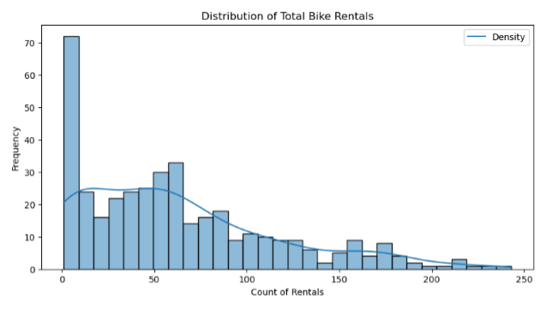
Exploring Dataset 3
PLOTS
• Histogram Plot with a KDE (Kernel Density Estimation) curve that shows the distribution of total bike rentals
INSIGHTS
Most rentals fall in a specific range, meaning demand is not evenly spread.
If the curve is skewed, it suggests more low or high rental values.
Helps understand common rental counts and detect outliers.

Slide 10
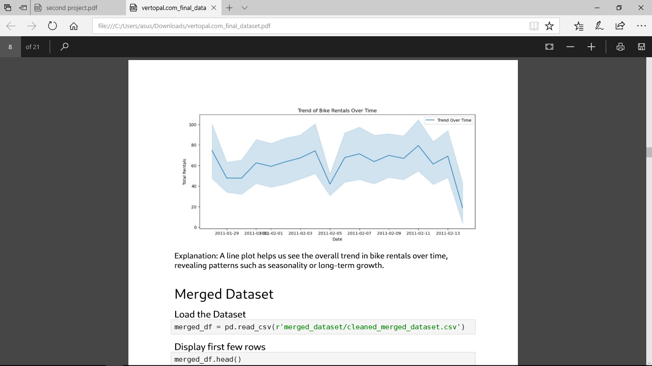
PLOTS
• Line plot that shows the trend of bike rentals over time.
INSIGHTS
Helps identify seasonal trends or fluctuations in bike rentals.
Detects high and low rental periods (e.g., weekends vs. weekdays).
Useful for spotting spikes or drops, which may indicate weather effects, holidays, or special events.

Slide 11
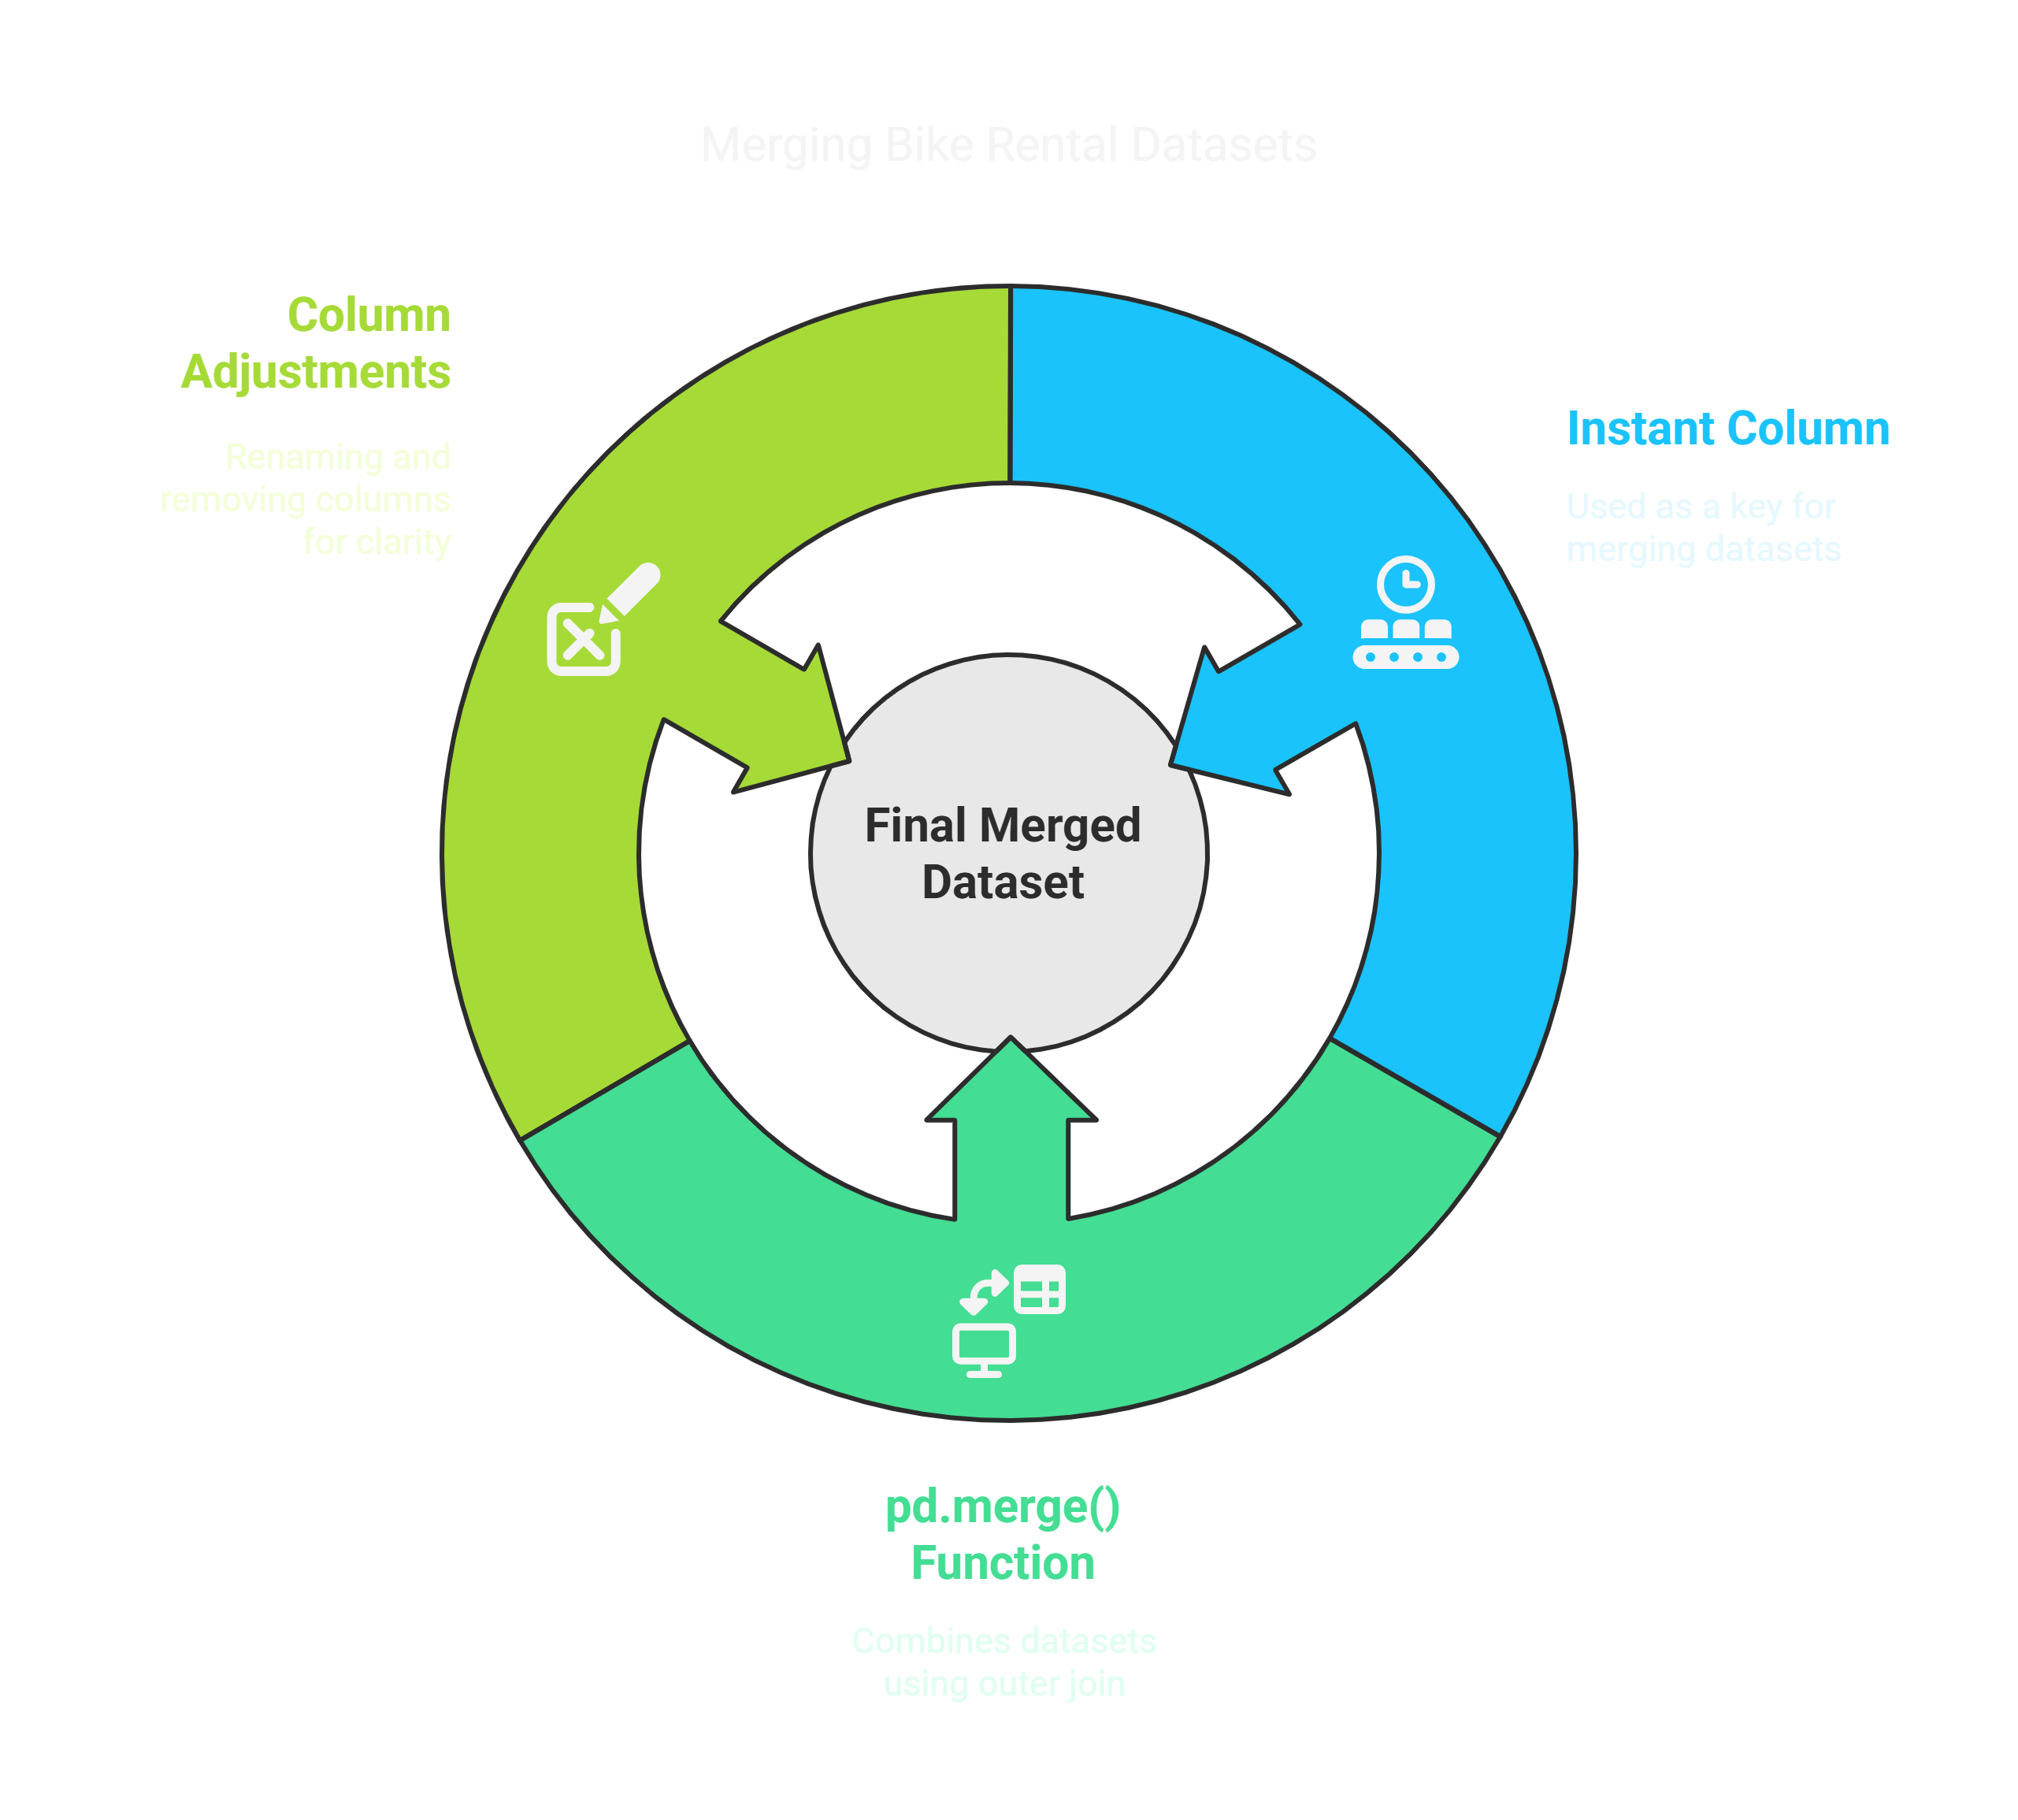
How We Merged the Final Datasets ?
Merged using instant column as a common key.
Used pd.merge() with how='outer' to combine all datasets.
Removed unnecessary _y columns after merging.
Renamed _x columns to original names.
Final dataset shape → 1000 rows, 16 columns.

Slide 12

Understanding Final Merged Dataset
KEY LEARNINGS
OUTLIERS - DETECTION
& HANDLING
OUTLIER ANALYSIS
& TREATMENT
No missing values after treatment.
Contains bike rental data with weather, season, temperature, humidity, and time details.
Weather and temperature impact bike rentals the most.
Outliers checked using Boxplots → Found in casual, registered, cnt (total rentals).
Used IQR Method (Interquartile Range) → Capped extreme values instead of removing them.
No extreme outliers after handling.
Remove outliers –
Extreme values distort analysis.
Better model accuracy.
Used capping (replacing extreme values with upper/lower bound).

Slide 13

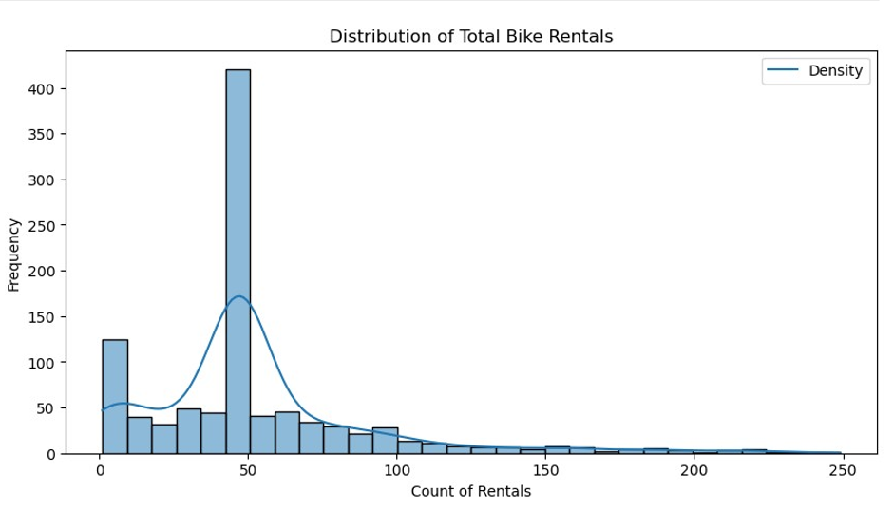
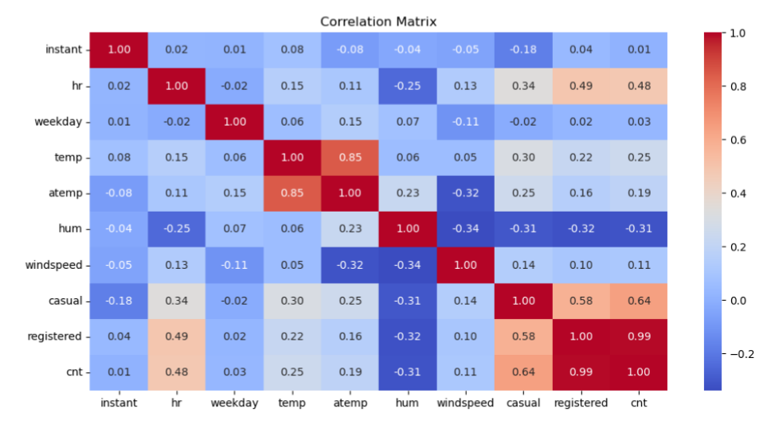
Plot Explanation
The x-axis represents the number of bike rentals (cnt).
The y-axis represents the frequency, showing how often different rental counts appear in the dataset.
The bars (histogram) represent the count of occurrences for different rental values
Low-variance and constant columns are removed, improving efficiency.
Ensures only meaningful features are kept for further analysis.
Correlation heatmap highlights relationships, revealing which features are dependent.

Slide 14
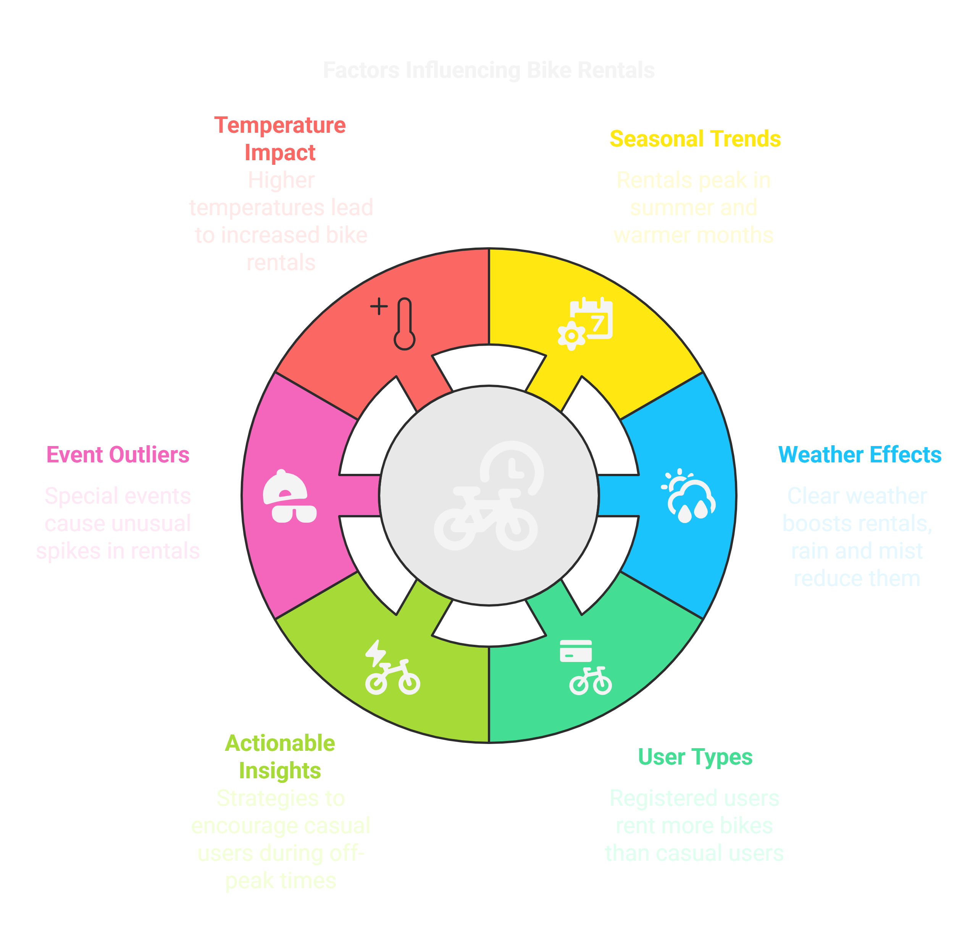
IMPORTANT INSIGHTS

Slide 15

Thank You!
Thank you for taking the time to check out my presentation. I truly appreciate your attention and interest. I hope you found the insights valuable and informative.
Once again, thank you for your time and support!

